Slide 1
CS162 Operating Systems and Systems Programming Lecture 14 Caching (Finished), Demand Paging
October 15th, 2017
Ion Stoica
http://cs162.eecs.Berkeley.edu
Notes:
Ok, so let’s get started! This is lecture 14 and I will continue talking about caching, picking up where Anthony left off on Monday.
And towards the end of the lecture, I will introduce demand paging, which is also a form of caching.

Slide 2
Recall: In Machine Structures (eg. 61C) …
100ns
Caching is the key to memory system performance
Main
Memory
(DRAM)
Processor
Access time = 100ns
Main
Memory
(DRAM)
Second
Level
Cache
(SRAM)
Processor
10ns
100ns
Average Access time=(Hit Rate x HitTime) + (Miss Rate x MissTime)
HitRate + MissRate = 1
HitRate = 90% => Avg. Access Time=(0.9 x 10) + (0.1 x 100)=19ns
HitRate = 99% => Avg. Access Time=(0.99 x 10) + (0.01 x 100)=10.9 ns
Notes:
So, the role of a cache is to reduce the average memory access time. So, here we have a processor; if it directly needs to go to memory to access something, it takes 100ns.
Remember, processors are superfast, they compute in small cycles, and hence 100ns is a really long time for them.
If we add a second level cache, we can instead access the same data in 10ns, i.e.,10 times faster than directly going to memory.
To quantify the gain due to a cache, we can compute the average access time: and its simply the hit-rate (times we find it in the cache). …
So, we get an illusion that we can access the main memory at such a fast speed, due to caching.

Slide 3
Review: Direct Mapped Cache
Direct Mapped 2^{N} byte cache:
The uppermost (32 - N) bits are always the Cache Tag
The lowest M bits are the Byte Select (Block Size = 2^{M})
Example: 1 KB Direct Mapped Cache with 32 B Blocks
Index chooses potential block
Tag checked to verify block
Byte select chooses byte within block
31
9
4
0
Cache Tag
Cache Index
Byte Select
Ex: 0x50
Ex: 0x01
Ex: 0x00
Valid Bit
Cache Tag
Cache Data
Byte 31
:
Byte 1
Byte 0
0
0x50
Byte 63
:
Byte 33
Byte 32
1
2
3
:
:
:
Byte 1023
:
Byte 992
31
Notes:
Let’s use a specific example with realistic numbers: assume we have a 1 KB direct mapped cache with block size equals to 32 bytes.
In other words, each block associated with the cache tag will have 32 bytes in it (Row 1).
With Block Size equals to 32 bytes, the 5 least significant bits of the address will be used as byte select within the cache block.
Since the cache size is 1K byte, the upper 32 minus 10 bits, or 22 bits of the address will be stored as cache tag.
The rest of the address bits in the middle, that is bit 5 through 9, will be used as Cache Index to select the proper cache entry.
+2 = 30 min. (Y:10)

Slide 4
Fully Associative Cache
Fully Associative: Every block can hold any line
Address does not include a cache index
Compare Cache Tags of all Cache Entries in Parallel
Example: Block Size=32B blocks
We need N 27-bit comparators
Still have byte select to choose from within block
31
4
0
Cache Tag (27 bits long)
Byte Select
Ex: 0x01
Cache Tag
Valid Bit
Cache Data
=
Byte 31
:
Byte 1
Byte 0
=
Byte 63
:
Byte 33
Byte 32
=
=
:
:
:
=
Notes:
While the direct mapped cache is on the simple end of the cache design spectrum, the fully associative cache is on the most complex end.
It is the N-way set associative cache carried to the extreme where N in this case is set to the number of cache entries in the cache.
In other words, we don’t even bother to use any address bits as the cache index.
We just store all the upper bits of the address (except Byte select) that is associated with the cache block as the cache tag and have one comparator for every entry.
The address is sent to all entries at once and compared in parallel and only the one that matches are sent to the output. This is called an associative lookup.
Needless to say, it is very hardware intensive. Usually, fully associative cache is limited to 64 or less entries.
Since we are not doing any mapping with the cache index, we will never push any other item out of the cache because multiple memory locations map to the same cache location.
Therefore, by definition, conflict miss is zero for a fully associative cache. This, however, does not mean the overall miss rate will be zero.
Assume we have 64 entries here. The first 64 items we accessed can fit in.
But when we try to bring in the 65th item, we will need to throw one of them out to make room for the new item. This bring us to the third type of cache misses: Capacity Miss.
+3 = 41 min. (Y:21)

Slide 5
Set Associative Cache
N-way set associative: N entries per Cache Index
N direct mapped caches operates in parallel
Example: Two-way set associative cache
Cache Index selects a “set” from the cache
Two tags in the set are compared to input in parallel
Data is selected based on the tag result
31
8
4
0
Cache Tag
Cache Index
Byte Select
Valid
Cache Tag
Cache Data
Cache Data
Cache Tag
Valid
Cache Block 0
Cache Block 0
:
:
:
:
:
:
Compare
Sel1
1
Mux
0
Sel0
Compare
OR
Hit
Cache Block
Notes:
This is called a 2-way set associative cache because there are two cache entries for each cache index. Essentially, you have two direct mapped cache works in parallel.
This is how it works: the cache index selects a set from the cache. The two tags in the set are compared in parallel with the upper bits of the memory address.
If neither tag matches the incoming address tag, we have a cache miss.
Otherwise, we have a cache hit and we will select the data on the side where the tag matches occur.
This is simple enough. What is its disadvantages?
+1 = 36 min. (Y:16)

Slide 6
Where does a Block Get Placed in a Cache?
Example: Block 12 placed in 8 block cache
32-Block Address Space:
Block
no.
1 1 1 1 1 1 1 1 1 1 2 2 2 2 2 2 2 2 2 2 3 3
0 1 2 3 4 5 6 7 8 9 0 1 2 3 4 5 6 7 8 9 0 1 2 3 4 5 6 7 8 9 0 1
Direct mapped:
block 12 can go only into block 4 (12 mod 8)
Set associative:
block 12 can go anywhere in set 0 (12 mod 4)
Fully associative:
block 12 can go anywhere
Block
no.
0 1 2 3 4 5 6 7
Block
no.
0 1 2 3 0 1 2 3
Block
no.
0 1 2 3 4 5 6 7
Set 0
Set 1

Slide 7
Which block should be replaced on a miss?
Easy for Direct Mapped: Only one possibility
Set Associative or Fully Associative:
Random
LRU (Least Recently Used)
Miss rates for a workload:
2-way 4-way 8-way Size LRU Random LRU Random LRU Random
16 KB 5.2% 5.7% 4.7% 5.3% 4.4% 5.0%
64 KB 1.9% 2.0% 1.5% 1.7% 1.4% 1.5%
256 KB 1.15% 1.17% 1.13% 1.13% 1.12% 1.12%

Slide 8
What happens on a write?
Write through (WT): The information is written to both the block in the cache and to the block in the lower-level memory
Write back (WB): The information is written only to the block in the cache
Modified cache block is written to main memory only when it is replaced
Question is block clean or dirty?
Pros and Cons of each?
WT:
PRO: read misses cannot result in writes
CON: Processor held up on writes unless writes buffered
WB:
PRO: repeated writes not sent to DRAM processor not held up on writes
CON: More complex Read miss may require writeback of dirty data

Slide 9
Caching Applied to Address Translation
Virtual
Address
TLB
Physical
Memory
CPU
Physical
Address
Cached?
Yes
No
Save
Result
Translate
(MMU)
Data Read or Write
(untranslated)
Question is one of page locality: does it exist?
Instruction accesses spend a lot of time on the same page (since accesses sequential)
Stack accesses have definite locality of reference
Data accesses have less page locality, but still some…
Can we have a TLB hierarchy?
Sure: multiple levels at different sizes/speeds
Notes:
Remember how we used caching for address translation?

Slide 10
Recall: What Actually Happens on a TLB Miss?
Software traversed Page tables
On TLB miss, processor receives TLB fault
Kernel traverses page table to find PTE
If PTE valid, fills TLB and returns from fault
If PTE marked as invalid, internally calls Page Fault handler
Hardware traversed page tables:
On TLB miss, hardware in MMU looks at current page table to fill TLB (may walk multiple levels)
If PTE valid, hardware fills TLB and processor never knows
If PTE marked as invalid, causes Page Fault, after which kernel decides what to do afterwards
Most chip sets provide hardware traversal
Modern operating systems tend to have more TLB faults since they use translation for many things
Examples:
shared segments
user-level portions of an operating system

Slide 11
Transparent Exceptions: TLB/Page fault (1/2)
Faulting
Inst 1
Faulting
Inst 1
Faulting
Inst 2
Faulting
Inst 2
User
TLB Faults
OS
Software
Load TLB
Fetch page/
Load TLB
How to transparently restart faulting instructions?
(Consider load or store that gets TLB or Page fault)
Could we just skip faulting instruction?
No: need to perform load or store after reconnecting physical page

Slide 12
Transparent Exceptions: TLB/Page fault (2/2)
Faulting
Inst 1
Faulting
Inst 1
Faulting
Inst 2
Faulting
Inst 2
User
TLB Faults
OS
Software
Load TLB
Fetch page/
Load TLB
Hardware must help out by saving:
Faulting instruction and partial state
Need to know which instruction caused fault
Is single PC sufficient to identify faulting position????
Processor State: sufficient to restart user thread
Save/restore registers, stack, etc
What if an instruction has side-effects?

Slide 13
Consider weird things that can happen
What if an instruction has side effects?
Options:
Unwind side-effects (easy to restart)
Finish off side-effects (messy!)
Example 1: mov (sp)+,10
What if page fault occurs when write to stack pointer?
Did sp get incremented before or after the page fault?
Example 2: strcpy (r1), (r2)
Source and destination overlap: can’t unwind in principle!
IBM S/370 and VAX solution: execute twice – once read-only
What about “RISC” processors?
For instance delayed branches?
Example: bne somewhere ld r1,(sp)
Precise exception state consists of two PCs: PC and nPC (next PC)
Delayed exceptions:
Example: div r1, r2, r3 ld r1, (sp)
What if takes many cycles to discover divide by zero, but load has already caused page fault?

Slide 14
Precise Exceptions
Precise ⇒ state of the machine is preserved as if program executed up to the offending instruction
All previous instructions completed
Offending instruction and all following instructions act as if they have not even started
Same system code will work on different implementations
Difficult in the presence of pipelining, out-of-order execution, ...
MIPS takes this position
Imprecise ⇒ system software has to figure out what is where and put it all back together
Performance goals often lead to forsaking precise interrupts
System software developers, user, markets etc. usually wish they had not done this
Modern techniques for out-of-order execution and branch prediction help implement precise interrupts

Slide 15
Recall: TLB Organization
CPU
TLB
Cache
Memory
Needs to be really fast
Critical path of memory access
In simplest view: before the cache
Thus, this adds to access time (reducing cache speed)
Seems to argue for Direct Mapped or Low Associativity
However, needs to have very few conflicts!
With TLB, the Miss Time extremely high!
This argues that cost of Conflict (Miss Time) is much higher than slightly increased cost of access (Hit Time)
Thrashing: continuous conflicts between accesses
What if use low order bits of page as index into TLB?
First page of code, data, stack may map to same entry
Need 3-way associativity at least?
What if use high order bits as index?
TLB mostly unused for small programs

Slide 16
Reducing translation time further
CPU
TLB
Cache
Memory
As described, TLB lookup is in serial with cache lookup:
Machines with TLBs go one step further: they overlap TLB lookup with cache access.
Works because offset available early
10
Virtual Address
V page no.
offset
TLB Lookup
V
Access
Rights
PA
P page no.
offset
Physical Address
10

Slide 17
Overlapping TLB & Cache Access (1/2)
Main idea:
Offset in virtual address exactly covers the “cache index” and “byte select”
Thus can select the cached byte(s) in parallel to perform address translation
virtual address
Virtual Page #
Offset
physical address
tag / page #
index
byte

Slide 18
Overlapping TLB & Cache Access
Here is how this might work with a 4K cache:
What if cache size is increased to 8KB?
Overlap not complete
Need to do something else. See CS152/252
Another option: Virtual Caches
Tags in cache are virtual addresses
Translation only happens on cache misses
TLB
assoc
lookup
4K Cache
32
index
1 K
20
10
2
4 bytes
virtual page #
disp
00
Hit/
Miss
page #
=
Tag
Data
Hit/
Miss

Slide 19
Putting Everything Together: Address Translation
Physical
Memory:
Virtual Address:
Virtual
P1 index
Virtual
P2 index
Offset
PageTablePtr
Physical Address:
Physical
Page #
Offset
Page Table
(1st level)
Page Table
(2nd level)

Slide 20
Putting Everything Together: TLB
Physical
Memory:
Virtual Address:
Virtual
P1 index
Virtual
P2 index
Offset
PageTablePtr
Physical Address:
Physical
Page #
Offset
Page Table
(1st level)
Page Table
(2nd level)
TLB:
…

Slide 21
Putting Everything Together: Cache
Physical
Memory:
Virtual Address:
Virtual
P1 index
Virtual
P2 index
Offset
PageTablePtr
Physical Address:
Physical
Page #
Offset
Page Table
(1st level)
tag
index
byte
cache:
Page Table
(2nd level)
tag:
block:
TLB:
…
…

Slide 22
Break

Slide 23
Next Up: What happens when …
Process
virtual address
physical address
MMU
page#
PT
instruction
frame#
retry
page fault
offset
exception
frame#
Operating System
offset
update PT entry
Page Fault Handler
load page from disk
scheduler

Slide 24
Where are all places that caching arises in OSes?
Direct use of caching techniques
TLB (cache of PTEs)
Paged virtual memory (memory as cache for disk)
File systems (cache disk blocks in memory)
DNS (cache hostname => IP address translations)
Web proxies (cache recently accessed pages)
Which pages to keep in memory?
All-important “Policy” aspect of virtual memory
Will spend a bit more time on this in a moment

Slide 25
Impact of caches on Operating Systems (1/2)
Indirect - dealing with cache effects (e.g., sync state across levels)
Maintaining the correctness of various caches
E.g., TLB consistency:
With PT across context switches ?
Across updates to the PT ?
Process scheduling
Which and how many processes are active ? Priorities ?
Large memory footprints versus small ones ?
Shared pages mapped into VAS of multiple processes ?

Slide 26
Impact of caches on Operating Systems (2/2)
Impact of thread scheduling on cache performance
Rapid interleaving of threads (small quantum) may degrade cache performance
Increase average memory access time (AMAT) !!!
Designing operating system data structures for cache performance

Slide 27
Working Set Model
As a program executes it transitions through a sequence of “working sets” consisting of varying sized subsets of the address space
Address
Time

Slide 28
Cache Behavior under WS model
1
new working set fits
Hit Rate
0
Cache Size
Amortized by fraction of time the Working Set is active
Transitions from one WS to the next
Capacity, Conflict, Compulsory misses
Applicable to memory caches and pages. Others ?

Slide 29
Another model of Locality: Zipf
Likelihood of accessing item of rank r is α 1/rª
Although rare to access items below the top few, there are so many that it yields a “heavy tailed” distribution
Substantial value from even a tiny cache
Substantial misses from even a very large cache

Slide 30
Demand Paging
Modern programs require a lot of physical memory
Memory per system growing faster than 25%-30%/year
But they don’t use all their memory all of the time
90-10 rule: programs spend 90% of their time in 10% of their code
Wasteful to require all of user’s code to be in memory
Solution: use main memory as cache for disk
Processor
Control
Caching
Tertiary
Storage
(Tape)
Second
Level
Cache
(SRAM)
Main
Memory
(DRAM)
Secondary
Storage
(Disk)
Datapath
On-Chip
Cache

Slide 31
Illusion of Infinite Memory (1/2)
∞
TLB
Page
Table
Physical
Memory
512 MB
Disk
500GB
Virtual
Memory
4 GB
Disk is larger than physical memory ⇒
In-use virtual memory can be bigger than physical memory
Combined memory of running processes much larger than physical memory
More programs fit into memory, allowing more concurrency

Slide 32
Illusion of Infinite Memory (2/2)
∞
TLB
Page
Table
Physical
Memory
512 MB
Disk
500GB
Virtual
Memory
4 GB
Principle: Transparent Level of Indirection (page table)
Supports flexible placement of physical data
Data could be on disk or somewhere across network
Variable location of data transparent to user program
Performance issue, not correctness issue

Slide 33
Since Demand Paging is Caching, Must Ask…
What is block size?
1 page
What is organization of this cache (i.e. direct-mapped, set-associative, fully-associative)?
Fully associative: arbitrary virtual → physical mapping
How do we find a page in the cache when look for it?
First check TLB, then page-table traversal
What is page replacement policy? (i.e. LRU, Random…)
This requires more explanation… (kinda LRU)
What happens on a miss?
Go to lower level to fill miss (i.e. disk)
What happens on a write? (write-through, write back)
Definitely write-back – need dirty bit!

Slide 34
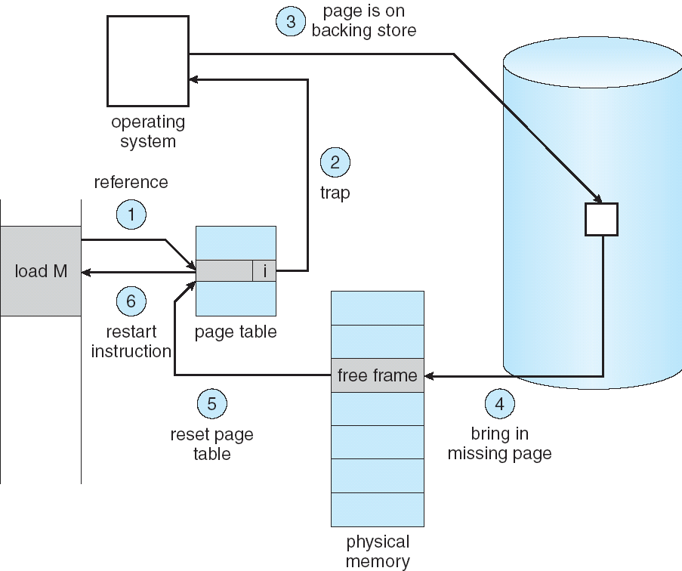
Summary: Steps in Handling a Page Fault

Slide 35
Summary
A cache of translations called a “Translation Lookaside Buffer” (TLB)
Relatively small number of PTEs and optional process IDs (< 512)
Fully Associative (Since conflict misses expensive)
On TLB miss, page table must be traversed and if located PTE is invalid, cause Page Fault
On change in page table, TLB entries must be invalidated
TLB is logically in front of cache (need to overlap with cache access)
Precise Exception specifies a single instruction for which:
All previous instructions have completed (committed state)
No following instructions nor actual instruction have started
Can manage caches in hardware or software or both
Goal is highest hit rate, even if it means more complex cache management
Notes:
No fancy replacement policy is needed for the direct mapped cache.
As a matter of fact, that is what cause direct mapped trouble to begin with: only one place to go in the cache--causes conflict misses.
No fancy replacement policy is needed for the direct mapped cache.
As a matter of fact, that is what cause direct mapped trouble to begin with: only one place to go in the cache--causes conflict misses.
Besides working at Sun, I also teach people how to fly whenever I have time.
Statistic have shown that if a pilot crashed after an engine failure, he or she is more likely to get killed in a multi-engine light airplane than a single engine airplane.
The joke among us flight instructors is that: sure, when the engine quit in a single engine stops, you have one option: sooner or later, you land. Probably sooner.
But in a multi-engine airplane with one engine stops, you have a lot of options. It is the need to make a decision that kills those people.

